Slide 1
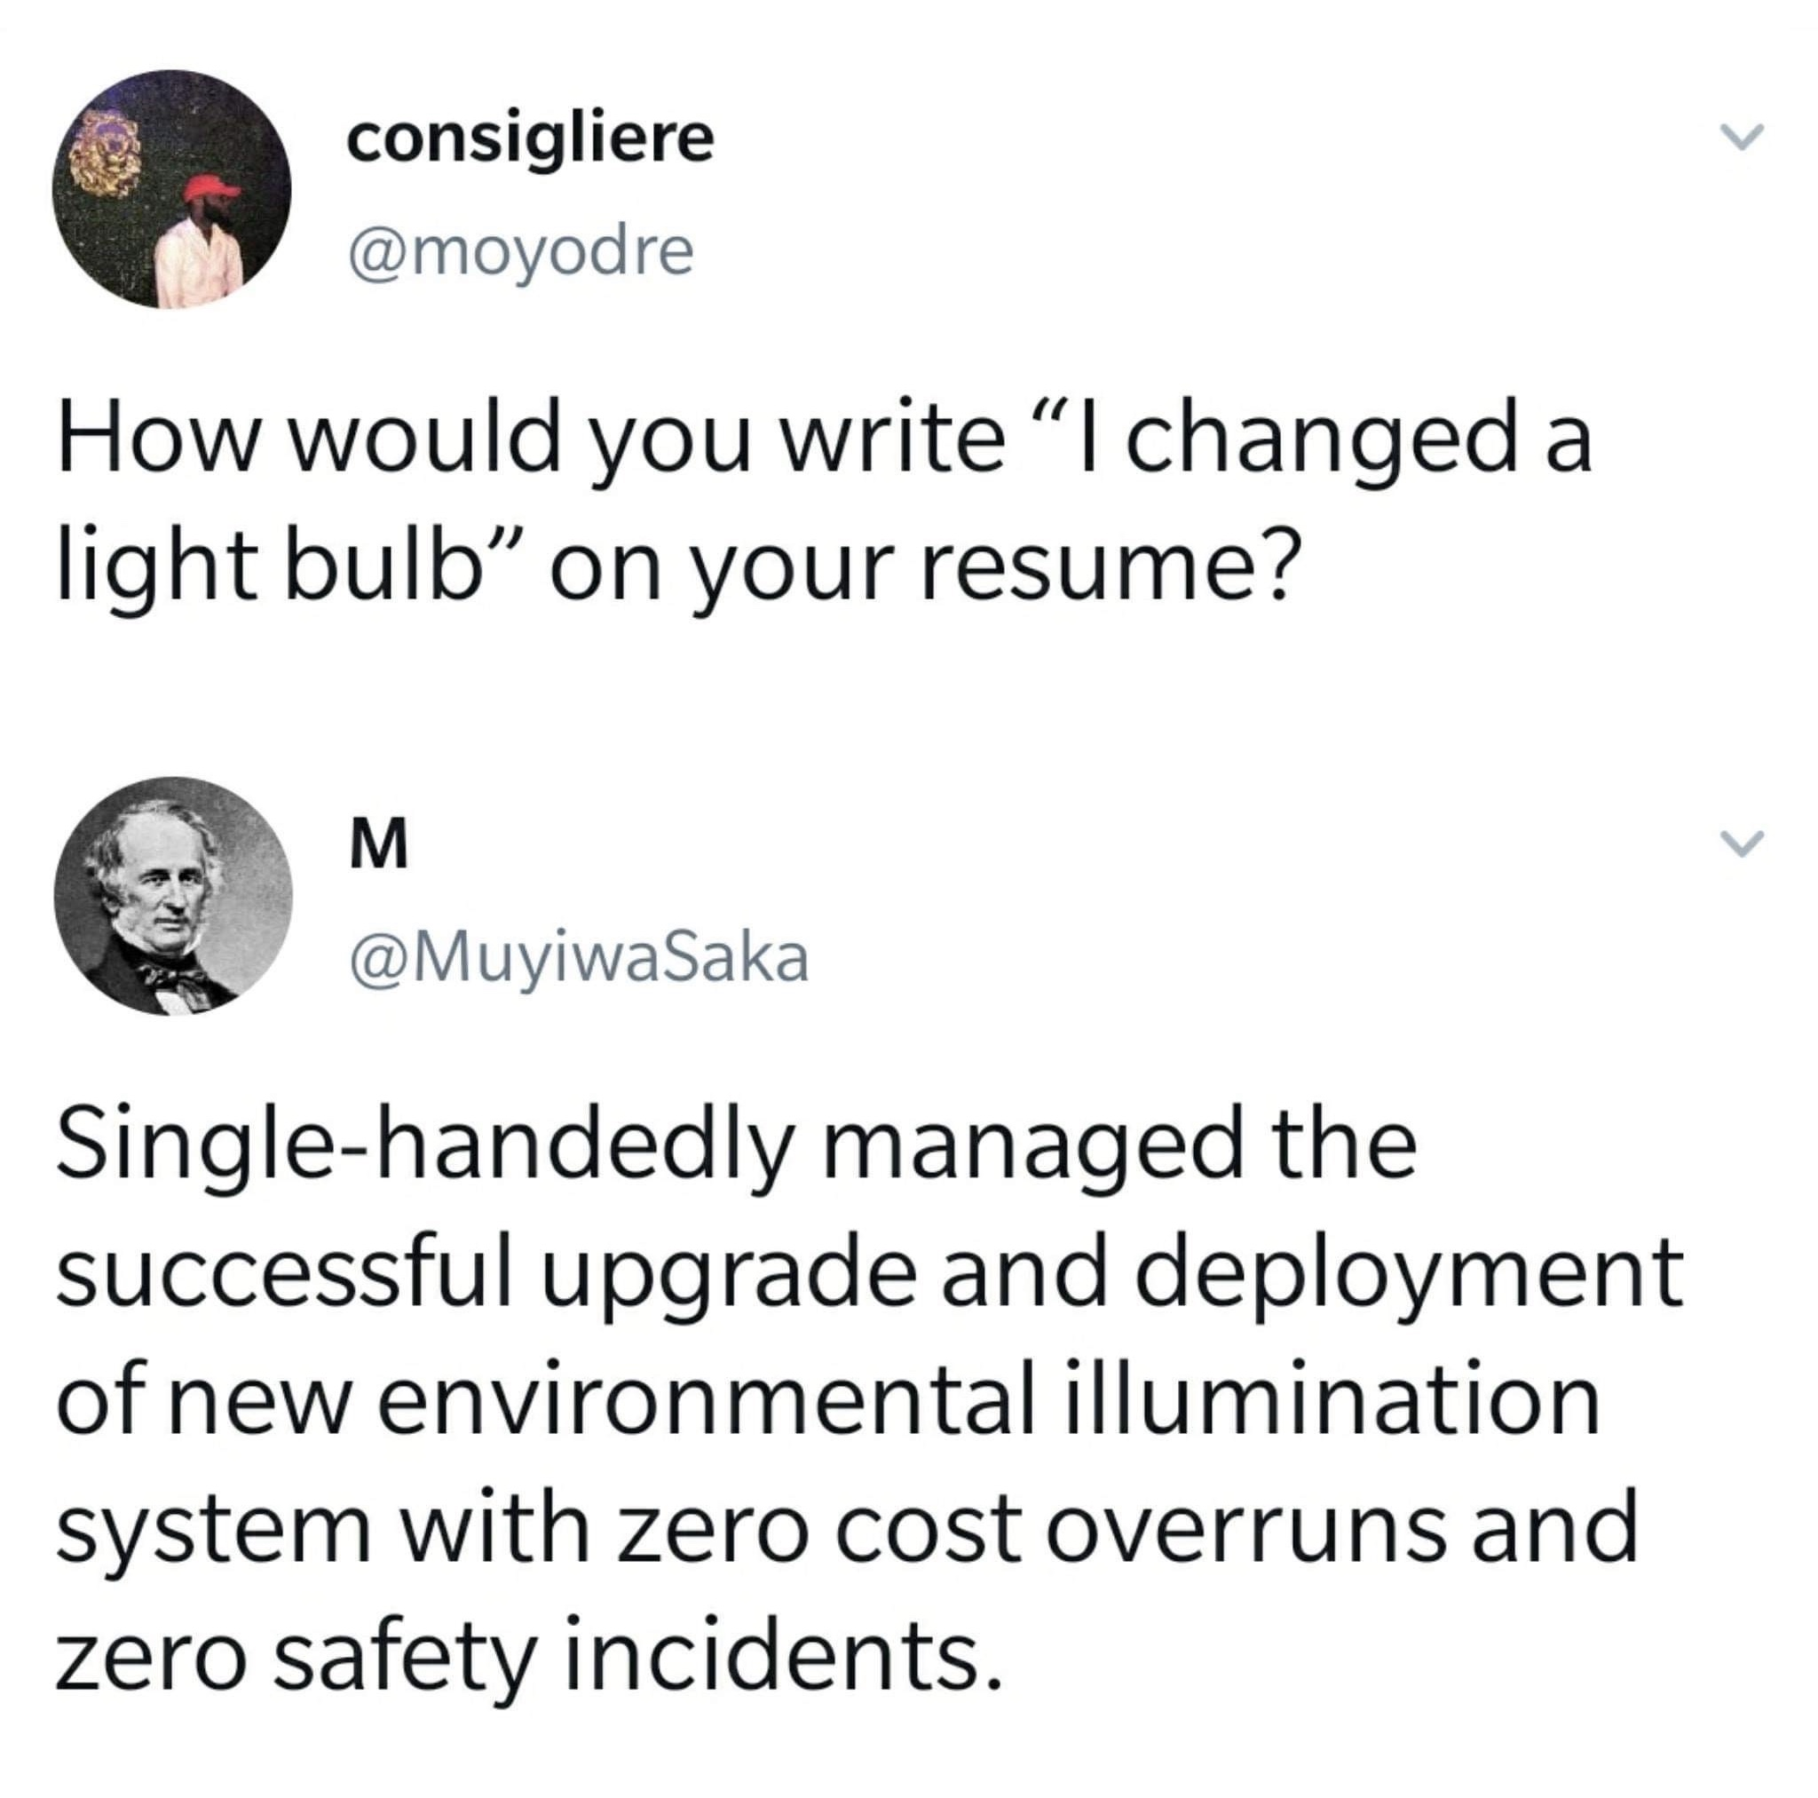
Resumes
*Remember with free advice you get what you pay for…

Slide 2
Resume Protip – Keep it short
Unless you have 10+ years of experience, there are very rarely reasons for a resume to be more than 2 pages.
Changing jobs every few months doesn’t give warm and fuzzies
We don’t need to know about that 4 day contracting gig you had in October 2008
No one wants to read a novel about every single thing you did at a every position you’ve ever had.
We don’t need to read about every single course you have taken on Coursera, LinkedIn Learning, YouTube, etc.

Slide 3


Slide 4
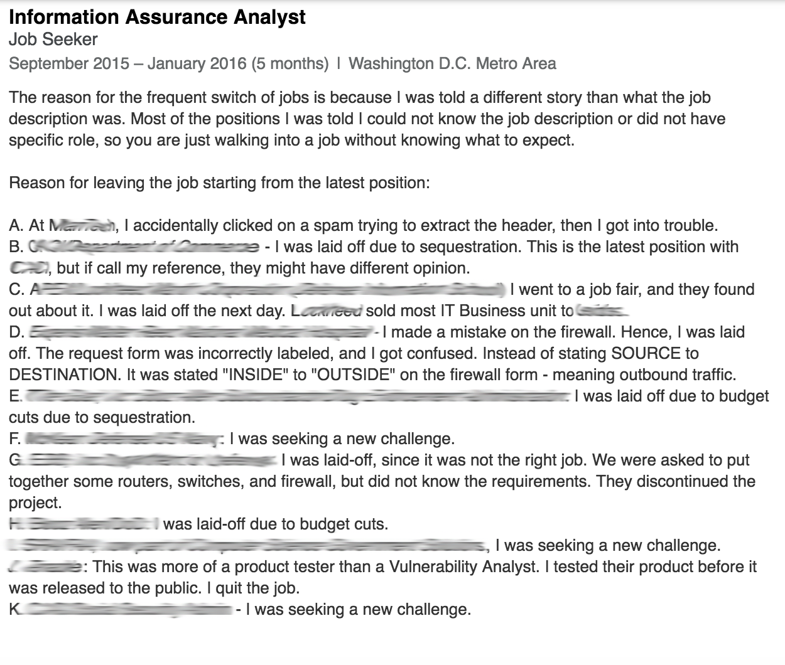
DON’T EVER DO THIS

Slide 5
Contact Information
Make sure your contact info is on your resume (and it’s accurate and that you check it!)
Have a professional email address
kevin.shivers@gmail.com - Yes
starwarsfan4life@gmail.com – Dicey
fireballshots4days@gmail.com - No

Slide 6
More Protips
Don’t list a skill or technology on there unless you feel comfortable talking about it in an interview
Watching over someone’s shoulder create an account in AD does not make you a Windows administrator
Installing Ubuntu in a VM and playing with it for an hour does not make you a Linux expert

Slide 7
More Protips
Don’t keep dead technologies on there
Who cares if you can run a Windows 3.1 system or a Palm Pilot?
Don’t have typos in your resume
Especially if you say you’re detail oriented

Slide 8
More Protips
"Experience using command line to look up hostnames” WHAT?
Keep it simple, don’t try to get clever

Slide 9
More Protips
Review the position description. Do you have skills in any of the areas they are looking for and you don’t mention that on the your resume?
Update your resume/cover letter to mention those skills and specific key words if they are in there.

Slide 10
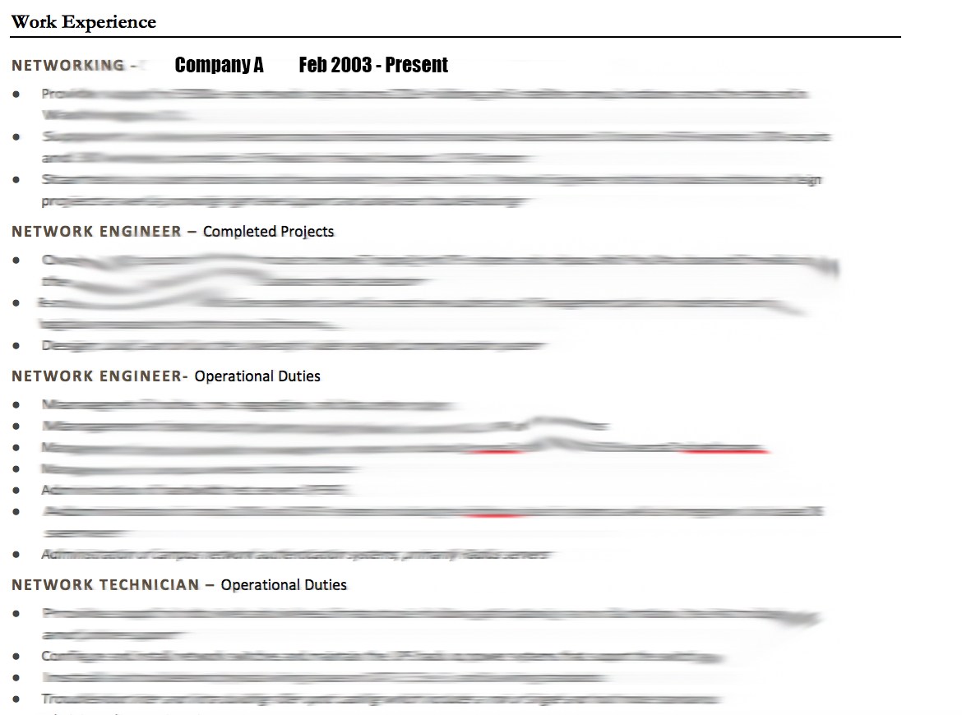
Don’t Do This

Slide 11
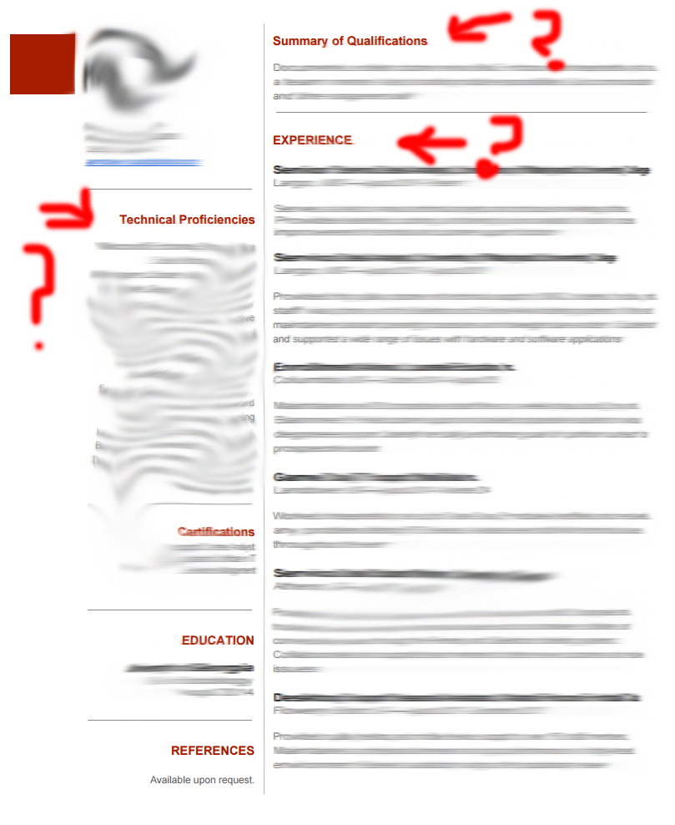
Or This

Slide 12
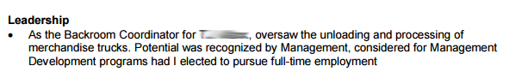
Is it still relevant?
After your first job no one cares about your GPA
List the institution, major, graduation date/year
If your overall GPA isn’t the best then put your major GPA. How do you define “major”?
Any class you’ve done well in?

Slide 13
Put more focus/bullet points on the most recent position(s)
Put less focus/bullet points on the older positions
List positions from most recent to oldest

Slide 14
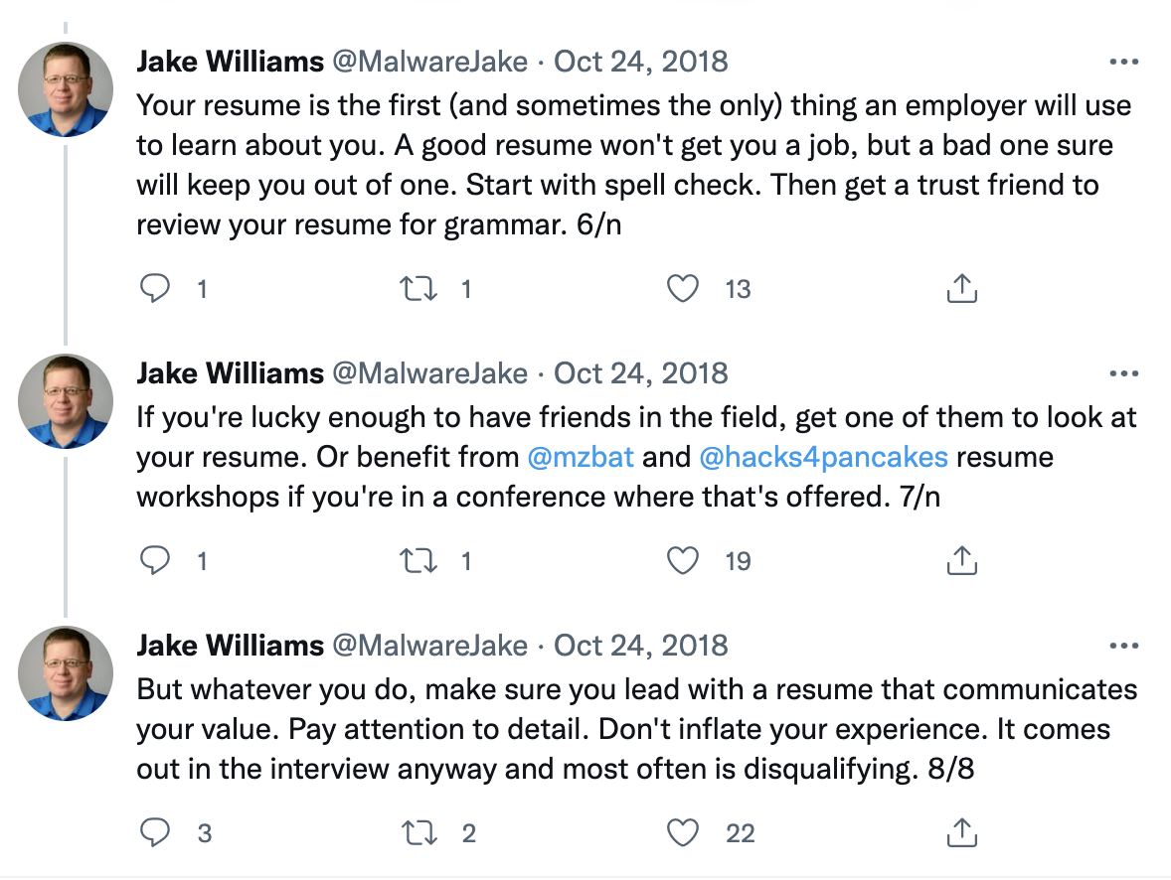
Malware Jake’s Resume Thoughts
https://twitter.com/MalwareJake/status/1055096994237239296

Slide 15
Cover Letters
Don’t submit a generic cover letter
If you don’t show passion for the job then I’m not going to show passion for you
Make a “templated” cover letter and insert relevant details for the job/company you are applying for (especially if it’s a job you REALLY want)

Slide 16
Cover Letters
Make sure you submit the correct templated cover letter.
“I’ve always wanted to work for XYZ Company” – Great good luck on your application for them, I’m hiring for UMD.

Slide 17
Cover Letters
Cover Letters are a great opportunity to ”sell yourself” to an employer
Cover letters are more free form than a resume so you can highlight specific accomplishments, skills, show off your skills researching a company
This is your electronic “elevator pitch”
Articulate who you are, why you are great, and what your aspirations are

Slide 18
PROOFREAD
PROOFREAD
PROOFREAD AGAIN
TAKE A NIGHT OFF AND PROOFREAD
HAVE A FRIEND PROOFREAD

Slide 19
After a Job Interview
Send a thank you email/call/letter
It may be old fashioned but people notice and will remember you

Slide 20
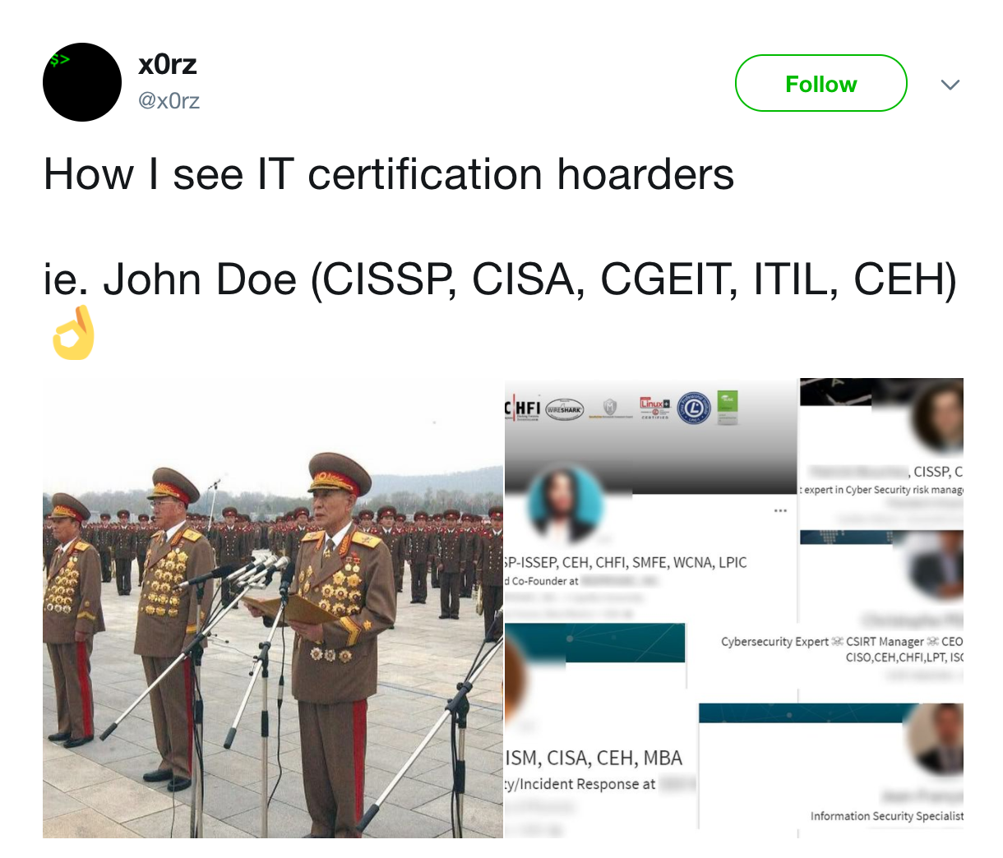

Slide 21
Experience > Certifications
If you don’t have the experience then certifications can help you get past an HR keyword search or show someone you have promise.

Slide 22
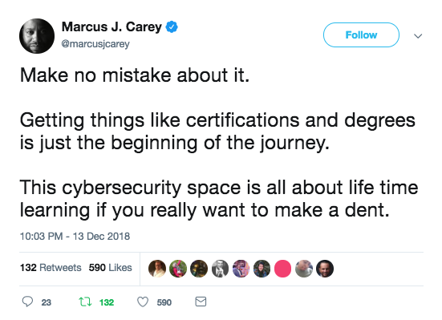

Slide 23
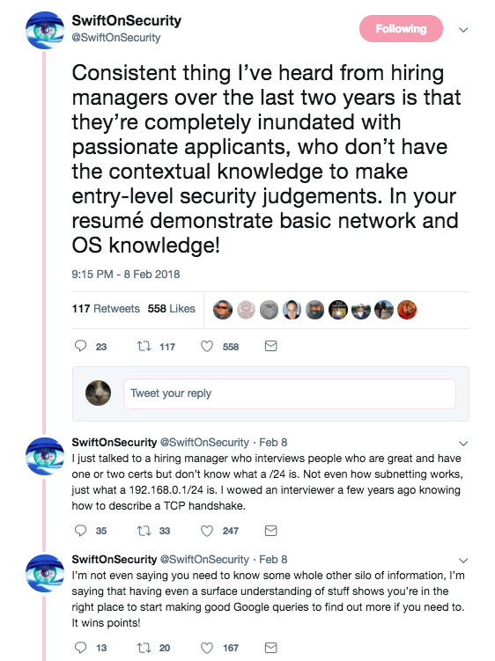
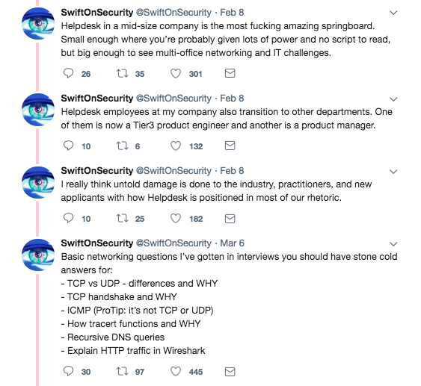
https://twitter.com/SwiftOnSecurity/status/961785484493180930

Slide 24
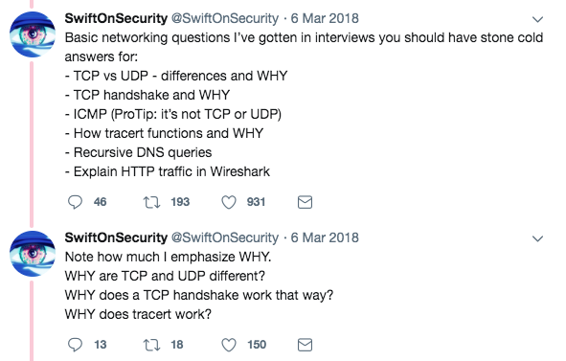

Slide 25
Certs that I feel are worth something:
SANS GIAC certs
OSCP
CISA
CISM
CCIE Security
CISSP

Slide 26
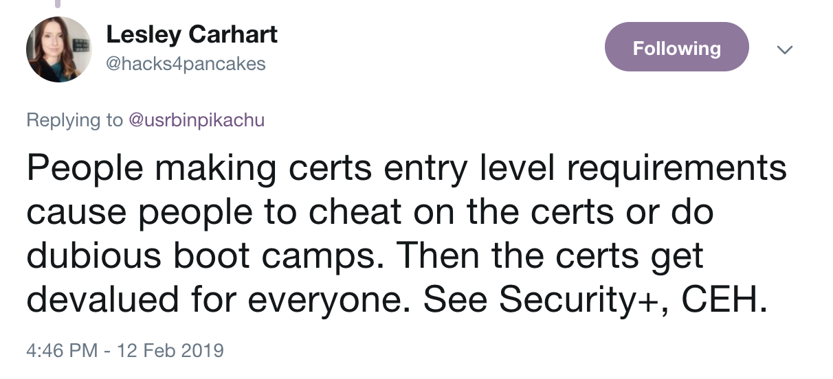
https://twitter.com/hacks4pancakes/status/1095439062884851712

Slide 27
CISSP
It’s the industry standard
It’s a mile wide and an inch deep
You kind of have this in this industry after you have 5+ years of professional experience
If you have the prerequisites for this then get it.

Slide 28
Pen Testing Certs Worth Something
Take what I say as a grain of salt but as a hiring manager these are the only pen testing certs I think are worth anything:
OSCP, OSWE, OSCE, OSEE (Offensive Security)
GPEN (SANS)
GXPN (SANS)

Slide 29
Don’t Waste Your Time…
CEH *
PenTest+ *
eCPPT
LPT
Others
* Unless you have absolutely nothing to list on a resume

Slide 30
Take advantage of work paying for education, training, certs

Slide 31
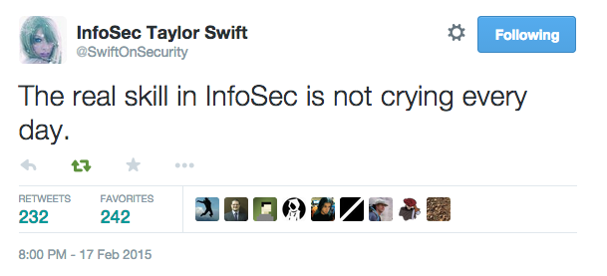
https://twitter.com/SwiftOnSecurity/status/567851173547401216

